Slide 1
Airway resistance
Dr. Tania Warnakulasuriya
Department of Physiology

Slide 2
Lecture objectives
Airway resistance
Work of breathing
Obstructive Airway Disease
  Asthma
  COPD
    Chronic bronchitis
    Emphysema

Slide 3
Airway resistance
  The resistance to movement/flow of air
Flow = pressure difference (∆P)
resistance (R)
R= Pressure difference (∆P) from alveoli to mouth
Flow
Resistance is expressed in cm H₂0 / Liter / second

Slide 4
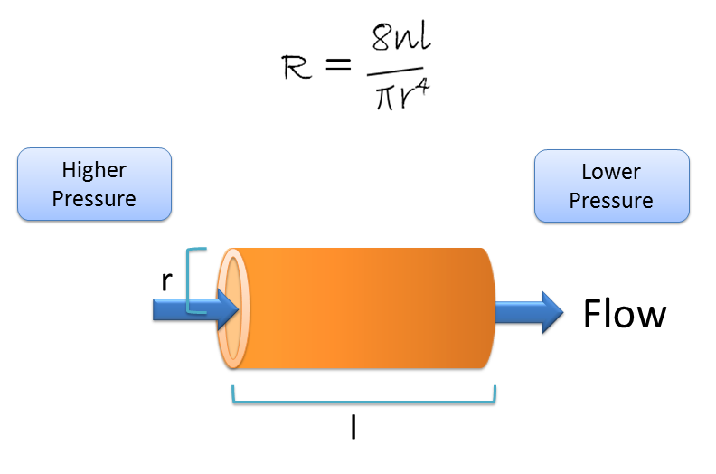
Poiseuille equation.
Flow = ∆P π r⁴
8ɳl
P = pressure difference
r = radius of tube
ɳ = viscosity of liquid
l = length of tube
Flow = pressure difference (∆P)
resistance (R)
R = ∆P
flow

Slide 5
Airway resistance
Depends on
Nature of air flow (laminar vs turbulent)
Airway calibre
Lung volume
Direction of flow

Slide 6
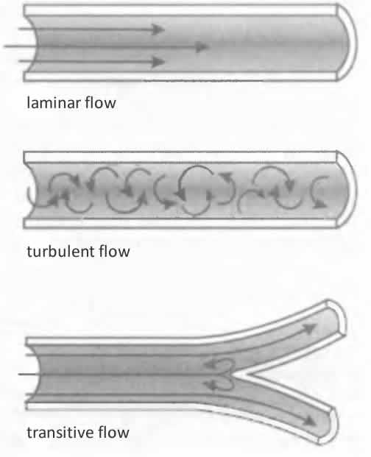
Effect of nature of flow in airways
Air flow in the larger airways is more turbulent
Laminar flow is more likely in smaller airways.
Therefore airway resistance is higher in larger airways (80%) than small peripheral airways (20%)
Highest in medium sized bronchi
Airway resistance increases at branch points – why?

Slide 7
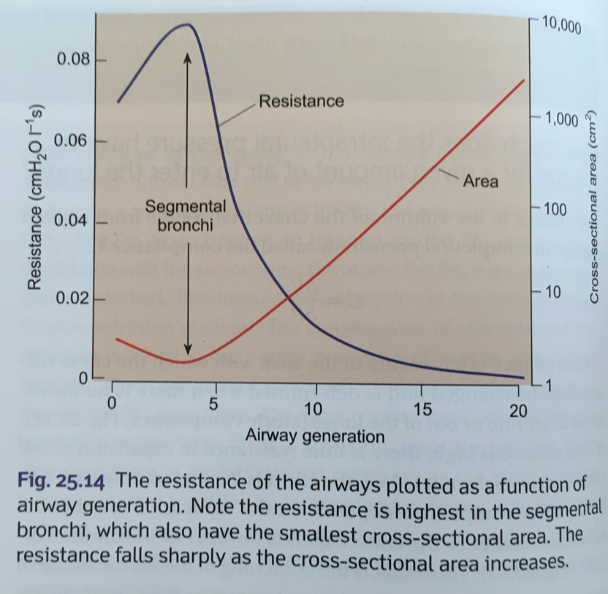

Slide 8
Effect of airway calibre (diameter/radius)
R ∝ 1/r⁴
Airway resistance increases as airway calibre decreases

Slide 9
Factors affecting airway calibre
Neural control :
Parasympathetic (Ach mediated) - bronchoconstriction
Sympathetic β₂ adrenergic - bronchodilation
Chemicals :
histamine, leukotrienes, substance P - bronchoconstriction
NO, VIP - bronchodilation
Cool air also causes bronchoconstriction
Bronchial muscle tone shows a diurnal rhythm with maximal constriction around 6.00 am

Slide 10
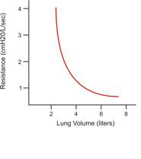
Effect of lung volume
The diameter of the airways which have only smooth muscular wall changes with alterations in intra-alveolar pressure
Lung volume ↑: r ↑ : AR ↓
Lung volume ↓ : r ↓ : ↑ AR

Slide 11
Why is the airway resistance higher
in larger airways?
during exercise?
in expiration?
in asthma

Slide 12
Why is the airway resistance higher
 | Laminar flow vs turbulence | Airway calibre | Lung volume | Direction of flow
in larger airways?
during exercise?
in expiration?
in asthma

Slide 13
Disorders due to increased airway resistance
Obstructive airway disease
  Reversible : asthma
  Non reversible : chronic obstructive airway disease
        chronic asthma
        chronic bronchitis
        emphysema

Slide 14
Bronchial asthma
Recurrent attacks of breathlessness, wheezing and/or cough
Due to inflammation of the air passages in the lungs and easily irritated airways (bronchial hyperreactivity)

Slide 15
In asthma
Main problem : reduction in airway diameter
  Bronchoconstriction
  Inflammation
    vascular congestion
    oedema of the bronchial wall
    thick mucus secretion
  Smooth muscle proliferation
Difficulty in breathing is more in expiration – why?

Slide 16
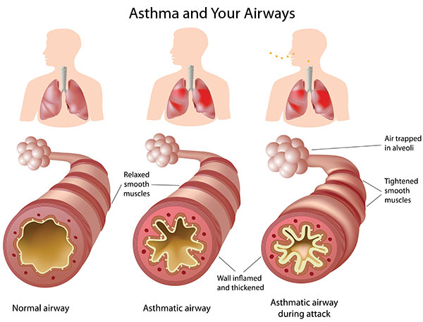

Slide 17
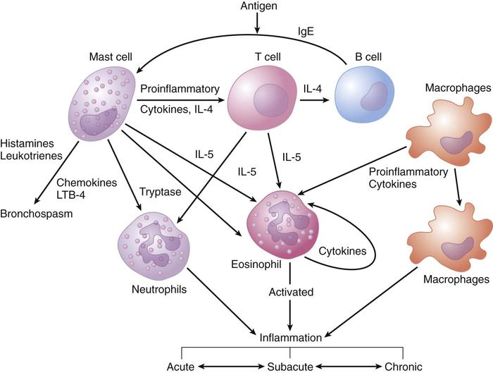
Pathogenesis
Allergen

Slide 18
Stimuli
Allergens - airborne pollens, other allergenic particles which cause a IgE mediated response
Infections - viruses are some of the commonest stimuli
Exercise - may be related to intake of cool air which causes bronchospasm
Environmental & air pollution - ozone, nitrogen dioxide, sulphur dioxide
Occupational factors - wood & vegetable dusts or chemicals
Pharmacologic agents - aspirin

Slide 19
Pathophysiolgical basis of treatment
Bronchodilation
  Sympathetic stimulation - β₂ agonists
  Methylxanthines inhibit phosphodiesterase and increase cAMP and relax smooth muscle
  Parasympathetic blockage - muscarinic receptor antagonists
Prevent or reverse inflammation
  glucocorticoids
  mast cell stabilizers (sodium cromoglycate)
  inhibitors of leukotriene synthesis or action
Elimination of causative agent - avoid exposure to allergens
Desensitisation – reduce reactivity

Slide 20
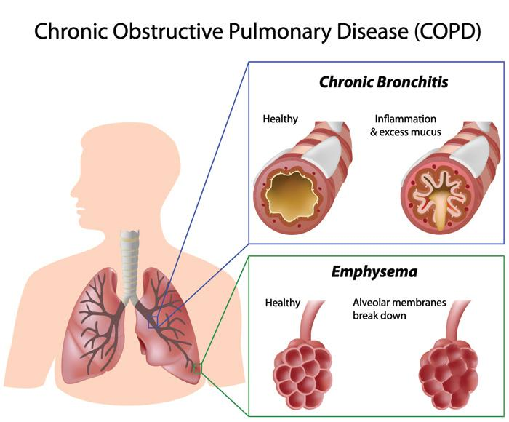

Slide 21
Main risk factors for COPD
Tobacco smoking
Indoor air pollution (such as biomass fuel used for cooking and heating)
Outdoor air pollution
Occupational dusts and chemicals (vapours, irritants, and fumes)

Slide 22
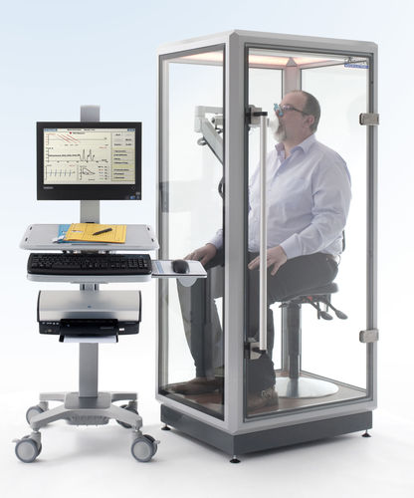
Physiological tests of airway resistance
Body plethysmography
  DIRECT MEASUREMENT
Peak expiratory flow metry
Spirometry
  INDICATES AIRFLOW LIMITATION

Slide 23
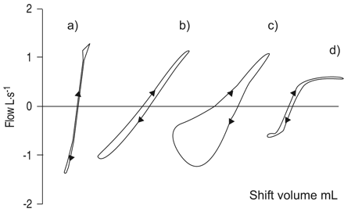
Something ‘nice’ to know
Schematic representation of specific resistance loops in a) a normal subject, b) a subject with increased large airway resistance, c) a subject with chronic airflow obstruction d) and a subject with upper airway obstruction. Mouth flow (V′) is plotted on the vertical axis, with inspiration positive and expiration negative. Shift volume is plotted on the horizontal axis.

Slide 24
What is work of breathing?
The physical work that has to be carried out by the muscles of respiration to overcome the elastic work of the respiratory system and the non-elastic work.

Slide 25
Work of breathing during quiet inspiration
Compliance work (Elastic work)
  To stretch the chest wall and lungs
  65% of work
Resistance work (Non-elastic work)
  Resistance to airflow - ‘airway resistance’ (28%)
  Resistance of tissues to movement ‘tissue/viscous resistance’ (7% )
Work of breathing is increased in forced respiration
  (exercise/ diseases)

Slide 26
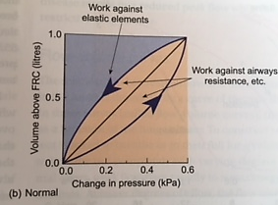
Work against elastic force
Work against air way resistance during inspiration and expiration

Slide 27
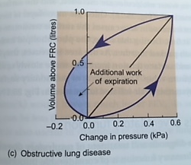
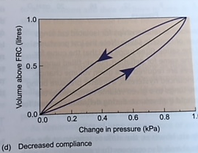
In obstructive airway disease
greater pressure change is required to move a given volume of air due to air way resistance.
In restrictive lung disease
greater pressure change is required to move a given volume of air due to low compliance.

Slide 28
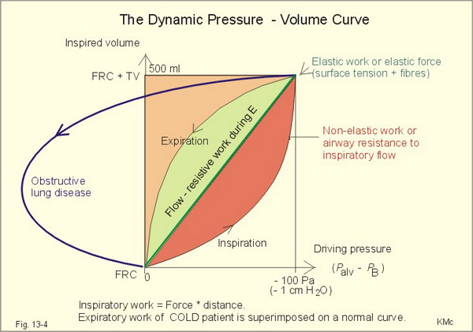

Slide 29
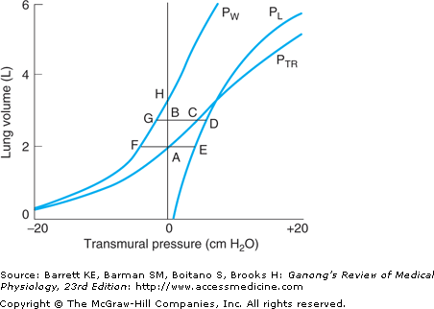
The work of breathing can be calculated from the pressure-volume curve
Total elastic work of the respiratory system – ABCA
Elastic work to increase the volume of the lungs – ABDEA
Total work is less, because part of it is done by the elastic energy stored in the chest wall

Slide 30
Can you remember?
Flow along the conducting system is by BULK FLOW and PRESSURE GRADIENTS created by changes in lung volume
Flow is influenced by the RESISTANCE of airways
i.e. the resistance to flow of air through the conducting airways of the lungs

Slide 31
Summary
Airway resistance
Work of breathing
  COMPLIANCE WORK
  AIRWAY RESISTANCDE
Obstructive Airway Disease
  Asthma
  COPD
    Chronic bronchitis
    Emphysema

